Slide 1

https://sahibulsaif.wordpress.com/wisdom/bismillah-nature/

Slide 2
ER Modeling
CSC271 – DATABASE SYSTEMS

Slide 3
Today’s Lecture
In this lecture, you will learn the following aspects of ER Model:
Entity types
Entity Instances
Attributes
Types of Attributes

Slide 4
ER Model
Conceptual design: (ER Model is used at this stage.)
What are the entities and relationships in the enterprise?
What information about these entities and relationships should we store in the database?
What are the integrity constraints or business rules that hold?
A database ‘schema’ in the ER Model can be represented pictorially (ER diagrams).
An ER diagram can be mapped into a relational schema.

Slide 5
ER Model Basics
Entity instance - person, place, object, event, concept (corresponds to row in table)
Entity Type – collection of entities (often corresponds to a table)
Attribute - property or characteristic of an entity type (corresponds to field in table)
Relationship instance – link between entities (corresponds to primary key-foreign key equivalencies in related tables)
Relationship type – category of relationship…link between entity types
Notes:
2

Slide 6
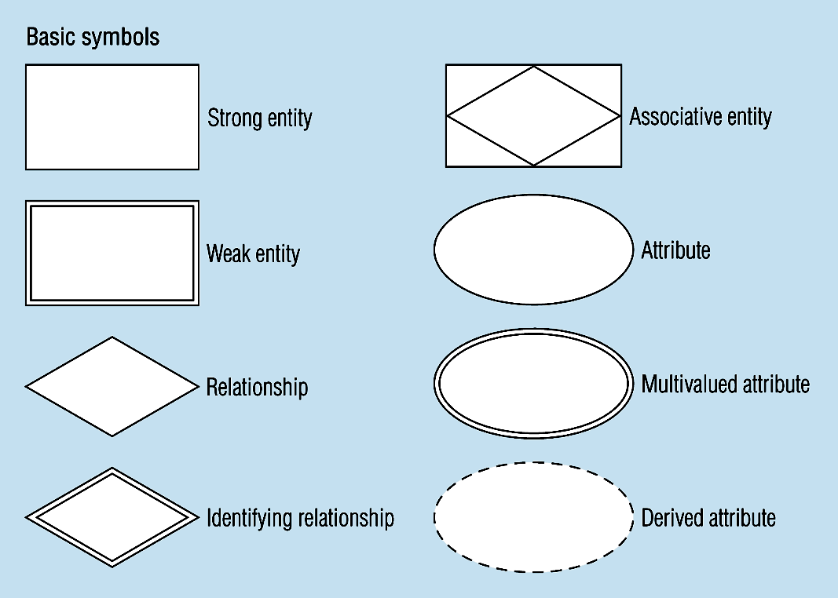
ER Model – Chen Notation
Entity symbols
A special entity that is also a relationship
Attribute symbols
Relationship symbols
Notes:
8

Slide 7
ER Model Basics
name
ssn
lot
Employees
Entity: Real-world object distinguishable from other objects. An entity is described (in DB) using a set of attributes.
Entity Set: A collection of similar entities. E.g., all employees.
All entities in an entity set have the same set of attributes.
Each entity set has a key.
Each attribute has a domain.
Notes:
3

Slide 8
ER Model - Attributes
Attribute - property or characteristic of an entity type
Classifications of attributes:
Simple versus Composite Attribute
Single-Valued versus Multivalued Attribute
Stored versus Derived Attributes
Notes:
5

Slide 9
ER Model - Attributes
Simple vs Composite
An atomic attribute is indivisible or indecomposable.
A composite attribute is one that is composed of smaller parts.
Example 1: A BirthDate attribute can be viewed as being composed of (sub-)attributes month, day, and year (each of which would probably be viewed as being atomic).
Example 2: An Address attribute can be viewed as being composed of (sub-)attributes for street address, city, state, and zip code. A street address can itself be viewed as being composed of a number, street name, and apartment number.

Slide 10
ER Model - Attributes
Single- vs. multi-valued
Consider a PERSON entity. The person it represents has (one) SSN, (one) date of birth, (one, although composite) name, etc. But that person may have zero or more academic degrees, dependents.
How can we model this via attributes Academic Degrees, Dependents.
One way is to allow such attributes to be multi-valued, which is to say that we assign to them a set of values rather than a single value.
To distinguish a multi-valued attribute from a single-valued one, it is customary to enclose the former within curly braces
PERSON(SSN, Name, BirthDate(Month, Day, Year), { AcademicDegrees(School, Level, Year) }, { Dependents }, ...)

Slide 11
ER Model - Attributes
Stored vs Derived
The value for the derived attribute is derived from the stored attribute.
For example 'Date of birth' of a person is a stored attribute. The value for the attribute 'AGE' can be derived by subtracting the 'Date of Birth'(DOB) from the current date.
Stored attribute supplies a value to the related attribute.

Slide 12
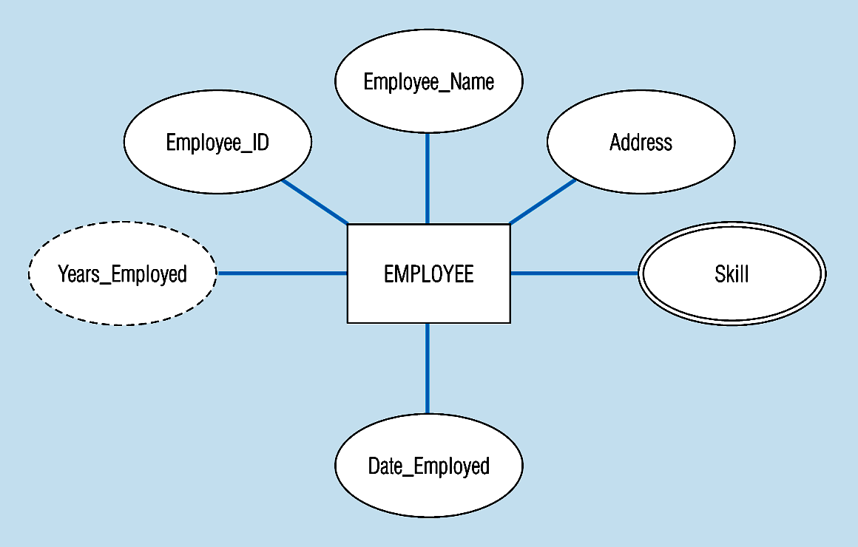
Entity with a multivalued attribute (Skill) and derived attribute (Years_Employed)
Multivalued:
an employee can have
more than one skill
Derived
from date employed and current date
Notes:
13

Slide 13
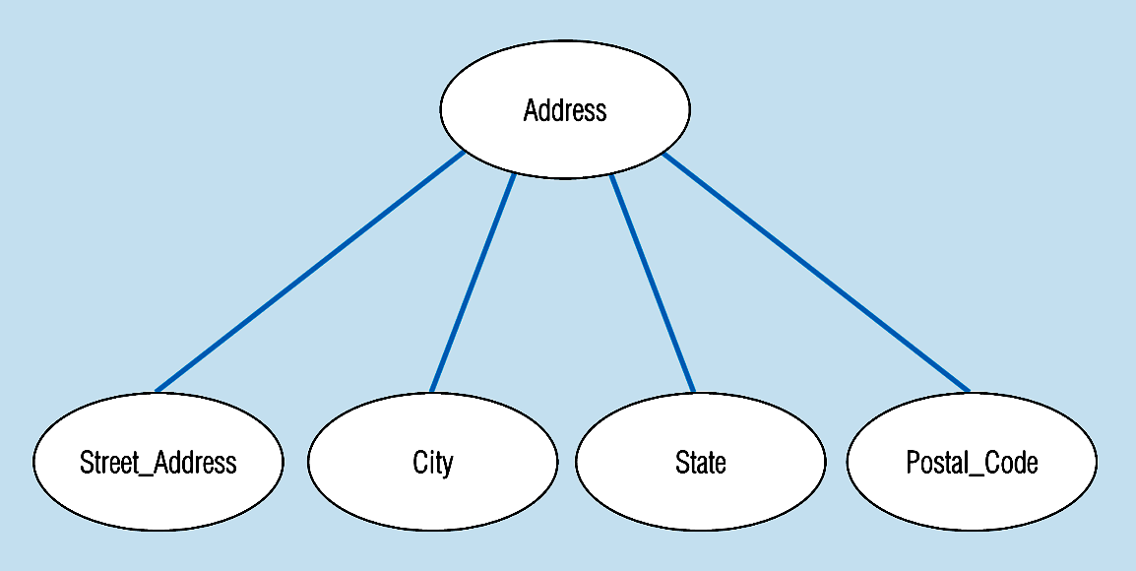
A composite attribute
An attribute broken into component parts
Notes:
12

